Slide 1

Home Credit Default Risk Prediction
Kaggle competition : https://www.kaggle.com/competitions/home-credit-default-risk
May 18, 2018 - Aug 30, 2018

Slide 2
Home Credit
Is an International consumer financial provider with operations in multiple European and Asian countries.
Default Risk
The risk a lender takes that a borrower will not make the required payments on a debt obligation such as a loan or a credit card.

Slide 3
Problem Overview
Many people struggle to get loans due to insufficient or non-existent credit histories. And, unfortunately, this population is often taken advantage of by untrustworthy lenders.
Home Credit has given some of the datasets by erasing personal details or the identities.
Our Task is to build a better machine learning model to help both Home Credit and borrowers by predicting default risk.

Slide 4
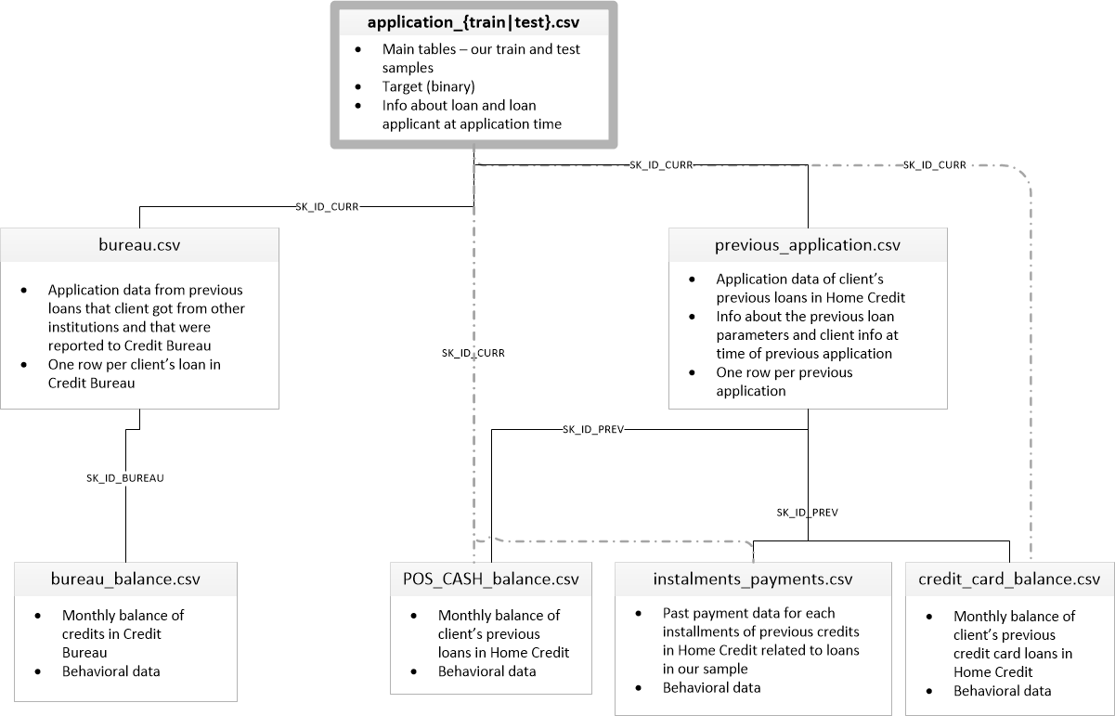

Slide 5
Solution
EDA on each Dataset
Feature Engineering and Combining Datasets
Distribution of the Target Variable
Sample the Dataset such that the Original Class Distribution is Preserved
Determine Evaluation Metrics
Convert Categorical Features
Exploration on XGBoost model
Model Performance on Selected Features based on EDA
Performance after Selecting Features with Feature Importance
Handling the Outliers

Slide 6
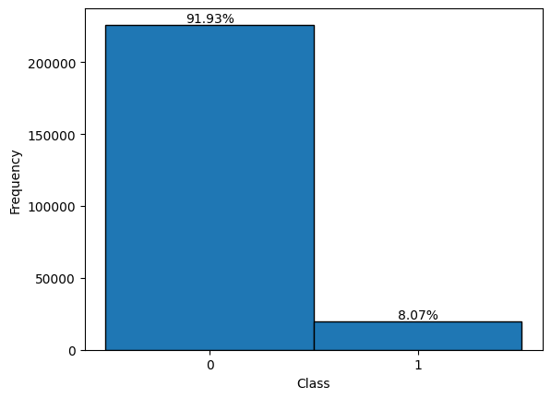
Distribution of the Target Variable

Slide 7
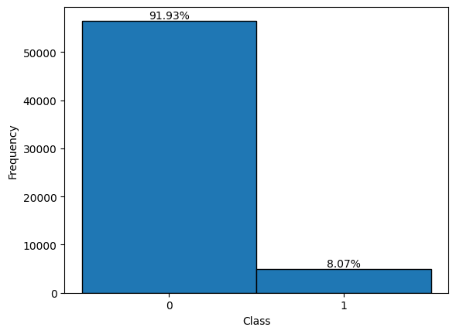
Sample the Dataset such that the Original Class Distribution is Preserved
Stratified Sampling is used
Distribution of Train Set
Distribution of Test Set

Slide 8
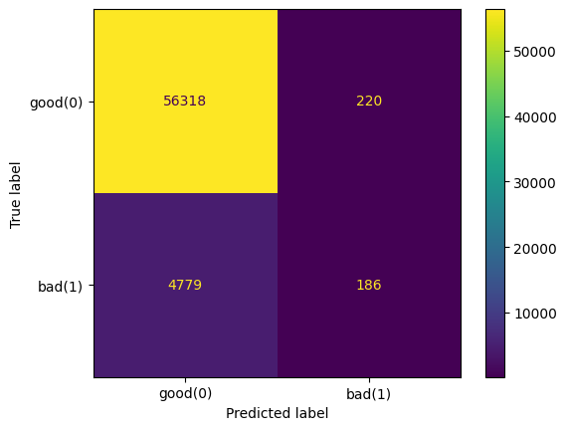

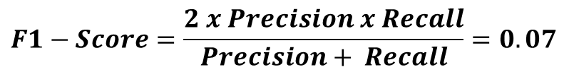
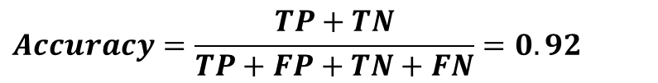
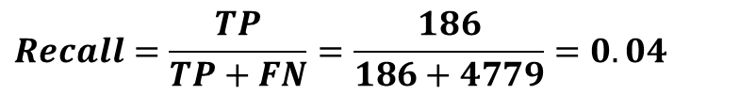
Determine Evaluation Metrics
Accuracy and Precision is not enough for highly imbalanced
$Precision=\frac{TP}{TP+FP}=\frac{186}{186+220}=0.46$
$$Recall=\frac{TP}{TP+FN}=\frac{186}{186+4779}=0.04$$
$$Accuracy=\frac{TP+TN}{TP+FP+TN+FN}=0.92$$
$$F1−Score=\frac{2 x Precision x Recall}{Precision+ Recall}=0.07$$

Slide 9
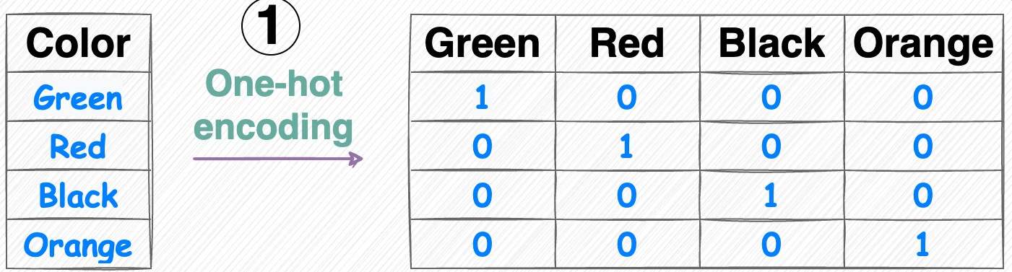
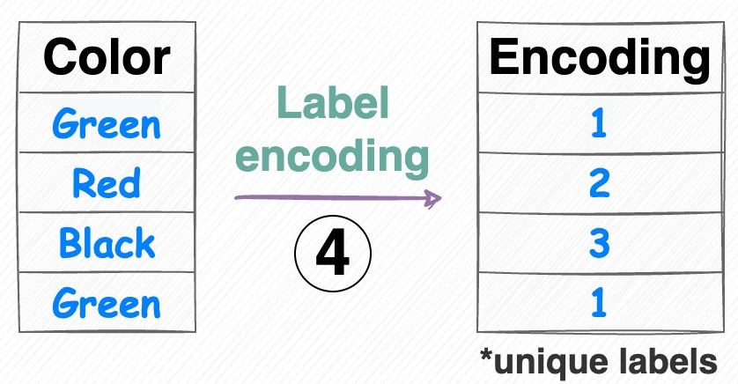
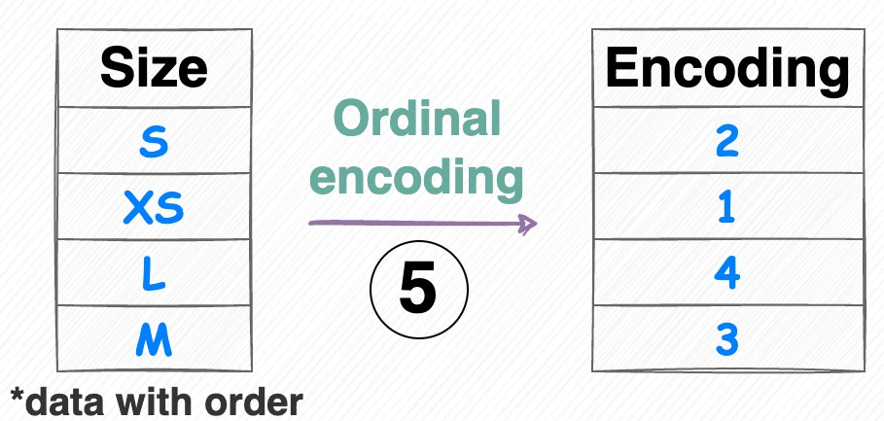
Convert Categorical Features
One Hot Encoding
Label Encoding
Ordinal Encoding
Occupation

Slide 10
How does XGBoost Work ?
Initialization
Calculate Residuals
Fit a Decision Tree
Calculate Similarity Score and Gain
Pruning
Calculate Leaf Weights/Outputs
Update Predictions
Repeat for Multiple Trees
Final Model
https://drive.google.com/file/d/1Of2qEVidq0EjRgV-iBboI_vFyV3p7cHs/view?usp=drive_link

Slide 11
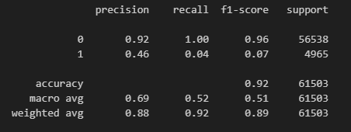
Model Performance on Selected Features based on EDA
Classification Report
Confusion Matrix

Slide 12
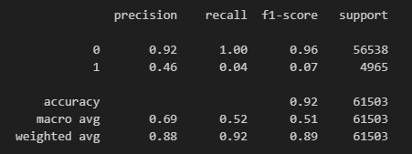
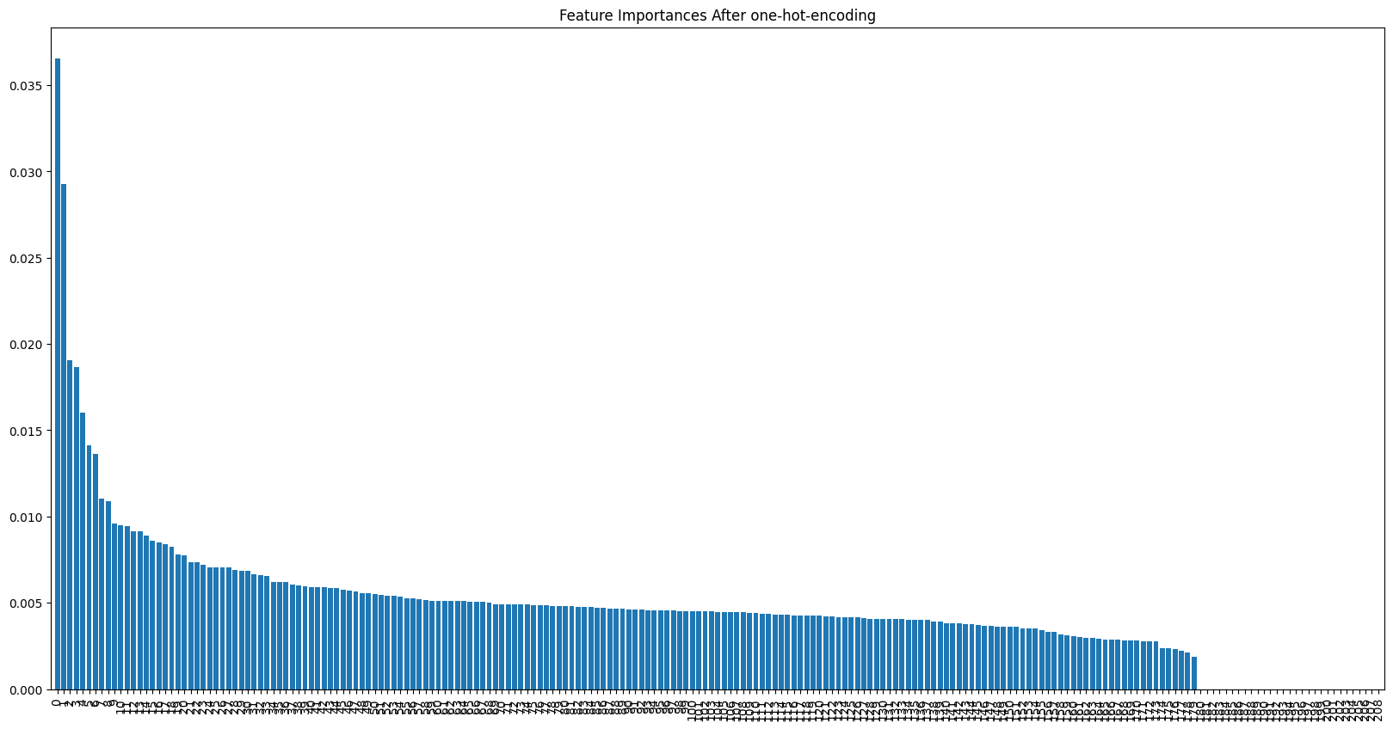
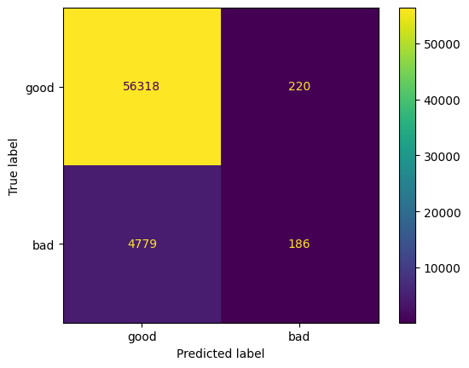
Performance after Selecting Features based on Feature Importance
Feature Importances in Decending Order

Slide 13
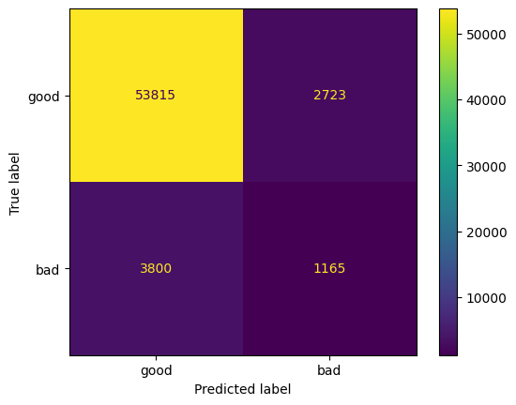
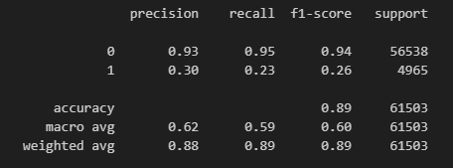
Performance after Tuning Some Hyperparameters
Classification Report
Confusion Matrix

Slide 14
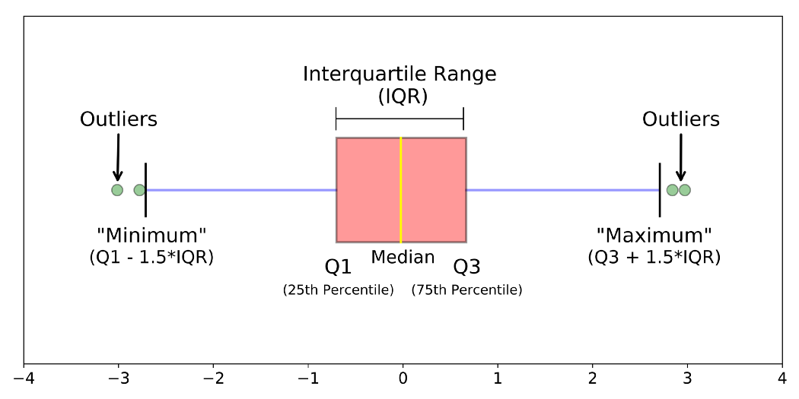
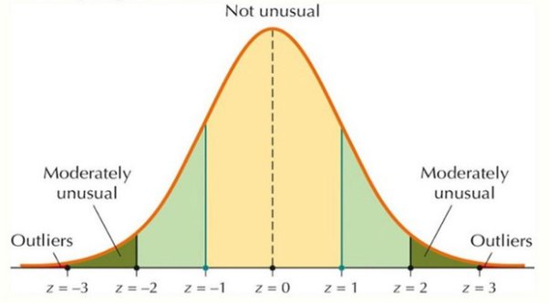
Handling the Outliers
IQR Method
Z-Score Method
Mahalanobies Distance + Chi-Square Distribution

Slide 15
Thank You

